Slide 1


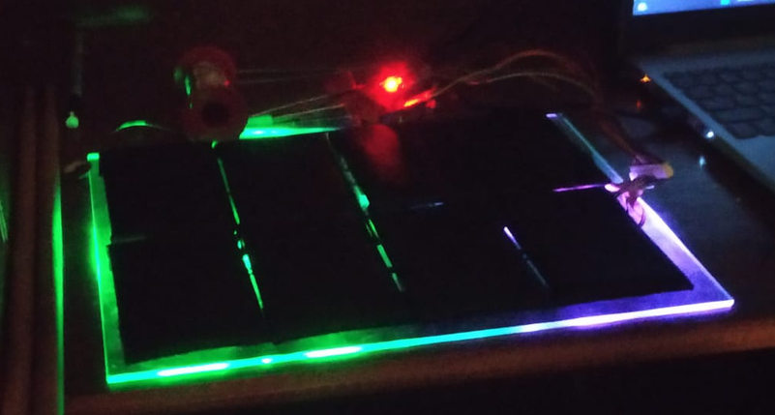

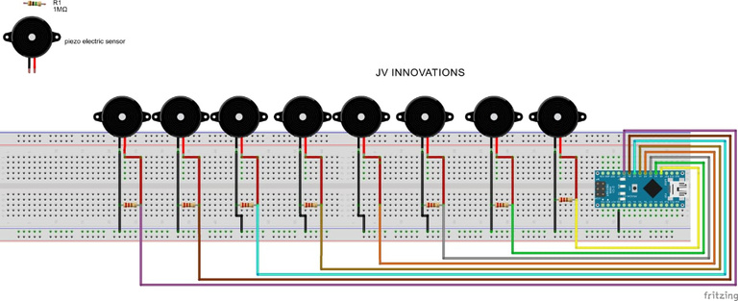
MIDI OCTOPAD WITH ARDUINO NANO
PROJECT PROPOSAL PRESENTATION

Slide 2

PROBLEM STATEMENT
MIDI OCTOPAD/ELECTRICAL DRUMS
30%
70%
MUSIC ENGAGING IN SOCIETY
TARGET/OBJECTIVE
ANYONE CAN LEARN MUSIC

Slide 3


OUR SOLUTION
ARDUINO ELECRTICAL DRUMS
25K-100K
EXISTING OCTOPAD/ELECTRICAL DRUMS
3K-5K
OUR PRODUCT
It has a feature which helps you to learn the music pad by yourself
It's affordable and less cost
User friendly and simple to use

Slide 4
1 | OUR PROJECT WORKS ON THE PRINCIBLE OF THE DETECTING VIBRATION
2 | WHEN A PERSON HIT THE PAD, IT SENSES THE VIBRATION AND SEND TO ARDUINO CONTROLLER
3 | THE ARDUINO PROCESS THE SINGAL AND SEND TO THE PC OR LAPTOP
4 | IN PC HAIRLESS MIDI THE SOFTWARE GET THE SOURCE WHICH SEND BY ARDUINO AND CONVERT IN MIDI FORM
5 | MIDI IS NOTHING BUT IT IS A MEDIA INTERFACE TO MUSIC INTERFACE
6 | THE CONVERTED SIGNAL SEND TO THE MUSIC SOFTWARE WHICH IS FLSTUDIO IT GIVES THE USER SET TONES AND MUSIC BEATS
WORKING:-
HARDWARES :-
ARDUINO NANO
ESP8266(wifi module)
PIEZO SENSOR
1M OHMS RESIST0R
ADRESSABLE LED
TOUCH SENSOR
SOUND SENSOR

Slide 5

Proposed Budget
COOMPONENTS | Value | QUANTITY
ARDUINO NANO | 550-800 | 1
ESP8266(WIFI MODULE) | 350-450 | 1
PIEZO ELECTRIC SENSOR | 1O | 8
1M OHMS RESISTOR | 1RS EACH | 8
ADRESSABLE LED | 300 | 1/2 METER
TTP22 TOUCH SENSOR | 1 | 15
TOTAL | APRROXIMATELY=2,000/-

Slide 6





Add Company Name
Merits over existing solution
A huge variance in the price
It's simple and compact for portability
Easy to control
Your able to learn the pad without attending any classes
same experience as the existing pads
.
.

